Slide 1
Lesson objective
Test Wednesday!
Title: Topic review
Aim – be able to:
Calculate mean, median and mode
Identify outliers and interpret graphs
Plan:
Step and leaf
Dot plot
Graphs

Slide 2
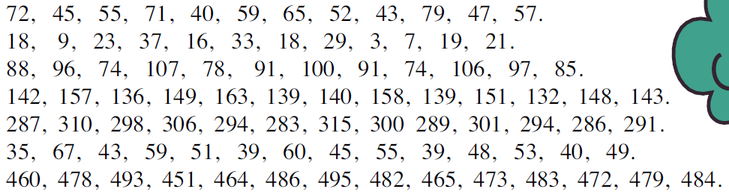
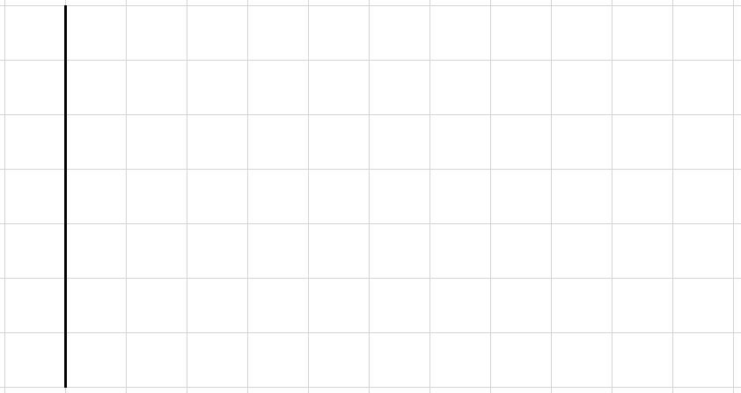

Putting data into a Stem and Leaf Diagram
Mean =
Mode =
Median =
Key:
means ____

Slide 3
Putting data into a Dot Plot
1, 2, 1, 5, 3, 4, 3, 2, 1, 3, 2, 5, 3, 4, 2, 1, 2, 1, 2, 1, 3, 4, 3, 2, 5, 4, 1, 2, 1, 3
Mean =
Mode =
Median =
1 2 3 4 5

Slide 4
Daily review: You try
21, 24, 76, 32, 24, 18, 52, 45, 67, 110, 45
In order:
Calculate the mean.
Calculate the mode
Calculate the median

Slide 5
Misleading representations
10
9
What is wrong with this graph?
What is it missing?
6
4
2

Slide 6
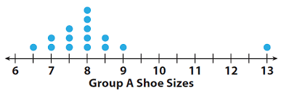
Think, pair and share.
How many people in the survey?
How many people have a shoe size of 8?

Slide 7
Skills check – can you….
Calculate mean, mode, median and range?
Identify outliers and say what they do?
Know how to make a dot plot and a stem and leaf?
Know when do use these?
Identify errors on a graph?
Page 315
Questions 7 – 14

